Slide 1

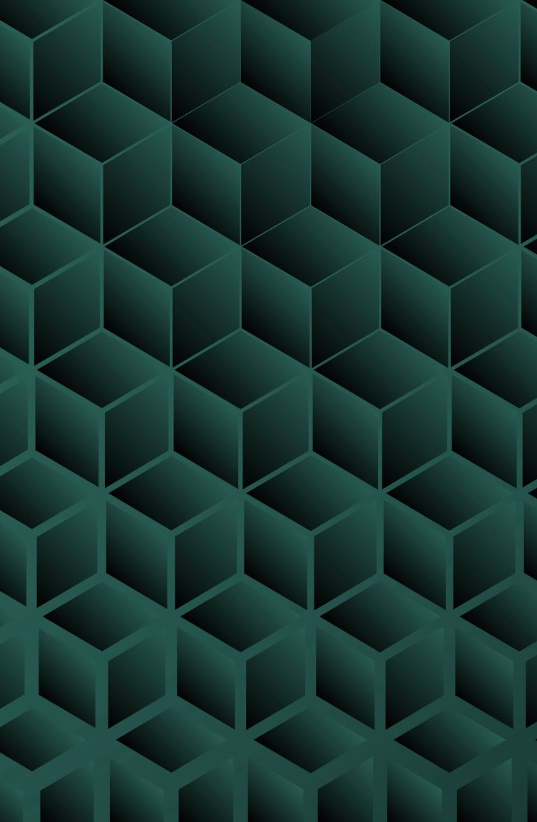
Hicklens Labyrynth
Developed By Jesse Hicklen

Slide 2
Overview:
This game is an action-adventure fantasy sci-fi mix.
The player explores a labyrinth, fights goblins and aliens, and searches for keys.
The main goal is to reach the final gate and activate an alien teleporter.
Fight goblins and alien enemies.
Navigate through the labyrinth without getting lost.
Find multiple keys hidden throughout the map.
Reach the final gate of the labyrinth.
Activate the alien teleporter to complete the game.

Slide 3
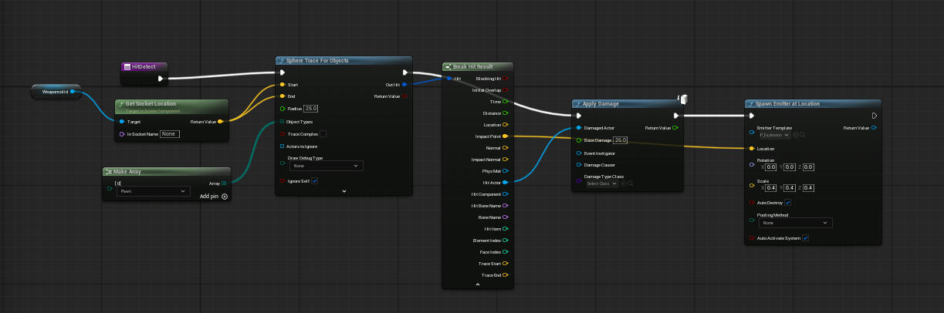
Game Mechanics
Hit Detection: Player’s gold sword detects overlap and

Slide 4
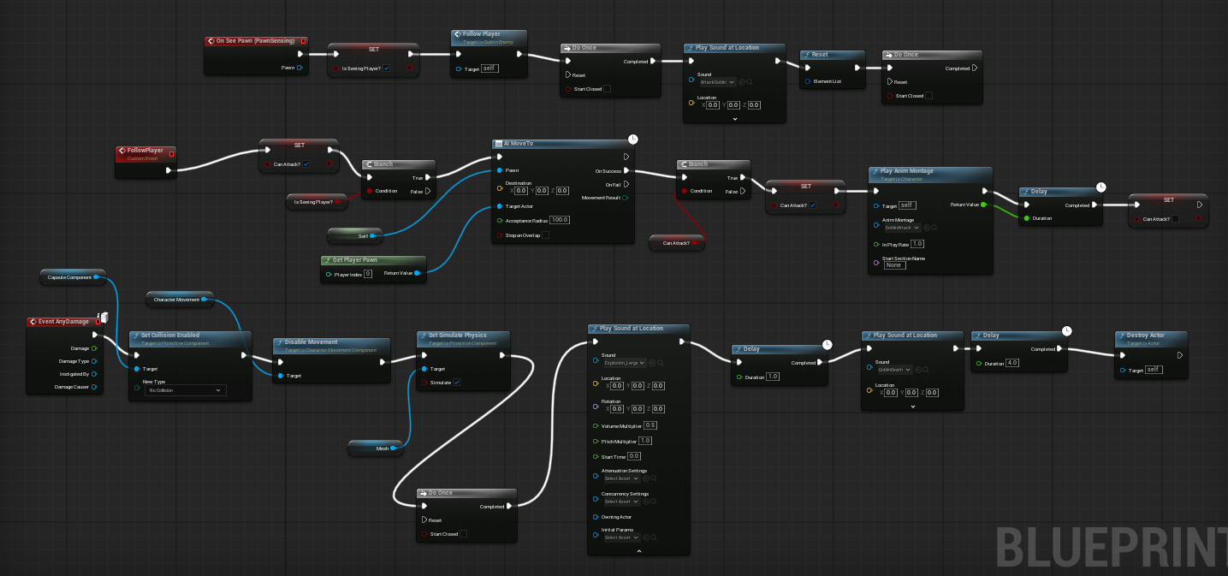
Enemy AI: Goblins see the player, speak once, then chase.

Slide 5
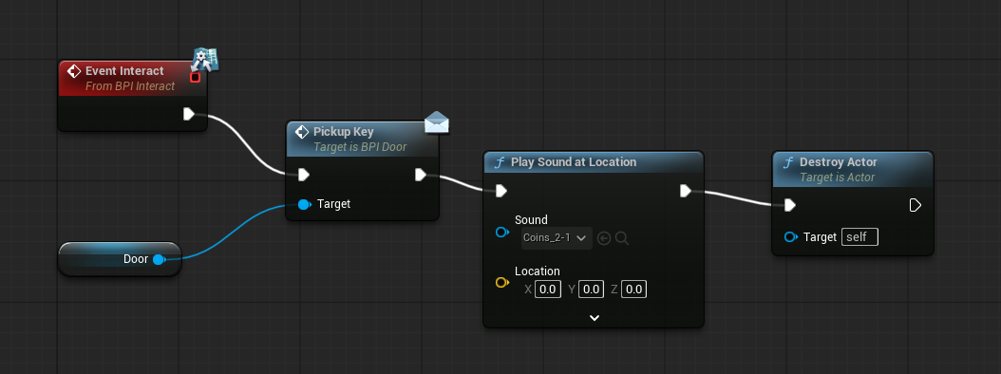
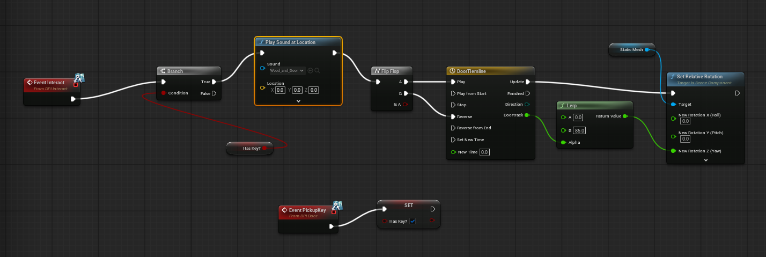
Key Collection: Keys unlock progress inside the labyrinth.

Slide 6
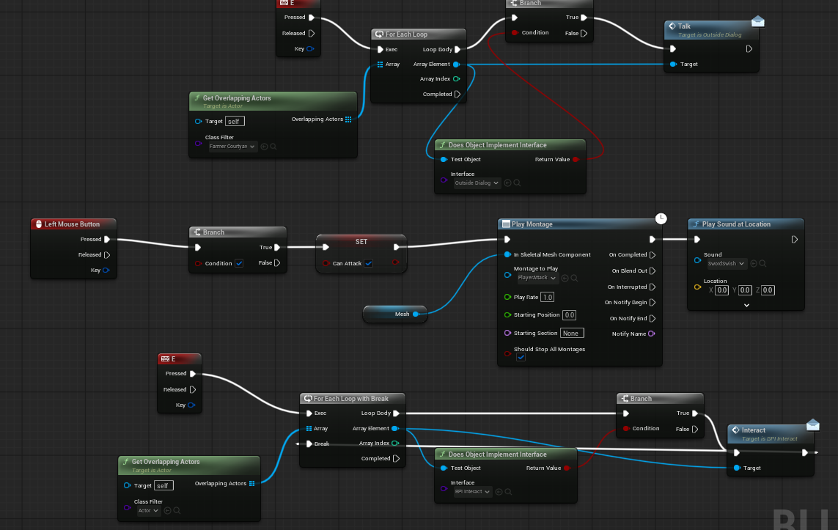
Player mechanics:

Slide 7
Video Link:
Hicklens Labyrynth

